Slide 1
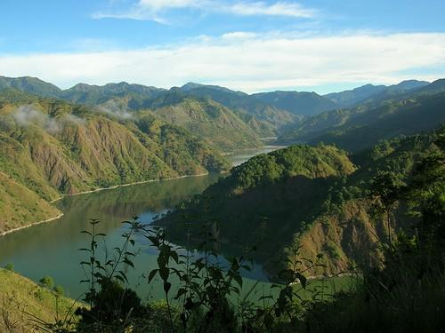
International Conference on Forest and Landscape Restoration (FLR)
ACIAR ASEM 2016/103 “Enhancing Livelihoods through Forest and Landscape Restoration”
Notes:
Ladies and gentlemen, good morning. It is truly a pleasure to be with you all in this very important event, the International Conference on Forest and Landscape Restoration (FLR), as part of the project on ACIAR ASEM 2016/103 entitled “Enhancing Livelihoods through Forest and Landscape Restoration”, with funding support from the Australian Government, as this brings together the practitioners and scientists on Forest and Landscape Restoration from across the globe.
I understand that today, 27 February 2019, is the last day of the 3-day event, yet, valuable discussions on the different initiatives are set to unfold. FLR is not really new as we are already applying some of its principles in our forest restoration efforts. However, embracing FLR and getting familiar with the terms and activities associated with FLR such as the landscapes, engagement of different stakeholders, multiple benefits that can be derived in doing FLR, maintenance and enhancement of ecosystem, resiliency and the like is another thing.

Slide 2
Executive Order No. 193, Series of 2015
Expanding the Coverage of the National Greening Program (NGP)
Notes:
Please note that the Philippines has a fair share of implementing FLR. Just recently, the Department of Environment and Natural Resources (DENR) has issued the Philippine’s Revised Implementing Rules and Regulations (IRR) on Executive Order No. 193, Series of 2015, Expanding the Coverage of the National Greening Program (NGP) wherein FLR is identified as the approach in developing the remaining unproductive and degraded forestlands of the country.

Slide 3
NGP ACCOMPLISHMENT (as of Dec 2018)
Year | Target Area | Area Planted | Seedlings Planted | %Accomp
2011 | 100,000 | 128,558 | 89,624,121 | 129%
2012 | 200,000 | 221,763 | 125,596,730 | 111%
2013 | 300,000 | 333,160 | 182,548,862 | 111%
2014 | 300,000 | 334,302 | 205,414,639 | 111%
2015 | 300,000 | 360,357 | 351,014,239 | 120%
2016 | 247,683 | 284,089 | 415,564,211 | 115%
2017 | 193,803 | 202,488 | 178,142,764 | 104%
2018 | 136,466 | 132,741 | 121,067,668 | 97%
TOTAL | 1,827,952 | 1,997,457 | 1,668,973,234 | 109%
Notes:
For information of everybody, NGP is a massive forest rehabilitation program of the Philippine government which seeks to grow 1.5 Billion trees in 1.5 Million hectares nationwide within a period of six years, from 2011-2016, and was extended from 2017 up to 2028. As of December 2018, NGP has already planted 1.67 Billion seedlings of various species in 1.8 Million hectares of open and degraded areas. Currently, more than 3 Million hectares remain plantable.

Slide 4
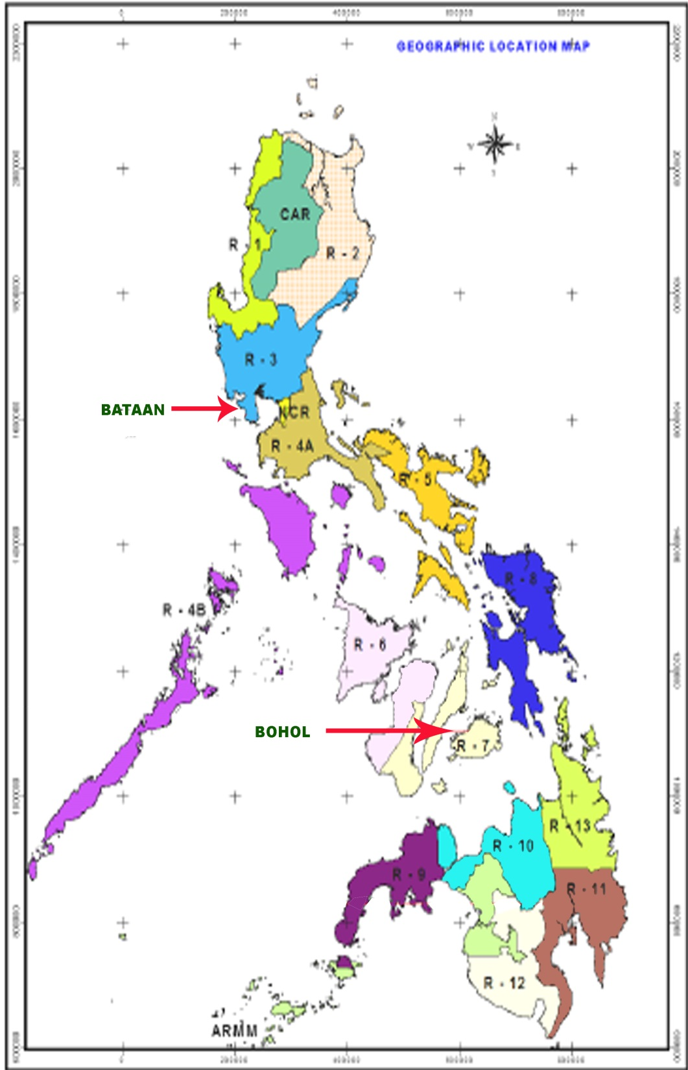
Philippine National Action Plan on Forest and Landscape Restoration (2016-18 through the Food and Agriculture Organization (FAO)
Notes:
Further, there are increasing support from private sectors and development partners, both in technical and financial aspects, to help restore or bring back our forests. One good example was the development of the Philippine National Action Plan on Forest and Landscape Restoration (2016-2018) through the Food and Agriculture Organization (FAO), which serves as basis in carrying out FLR actions. Continuing FLR actions are undertaken in Bohol in the Visayas and in Bataan in the Northern part of Luzon.

Slide 5
Notes:
FLR will be piloted to include the application of Assisted Natural Regeneration (ANR), agroforestry, establishment of firebreaks and greenbreaks, rainwater harvesting, Conservation Farming, Livelihood Programs, among others.

Slide 6
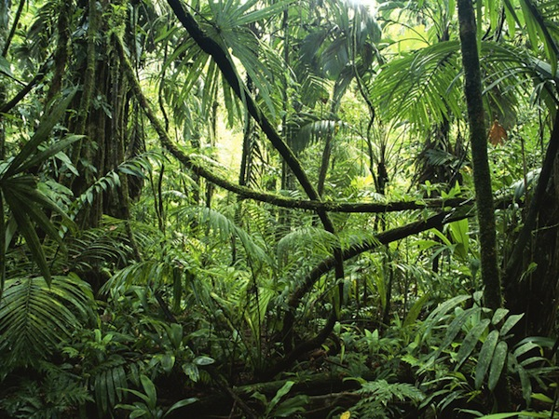
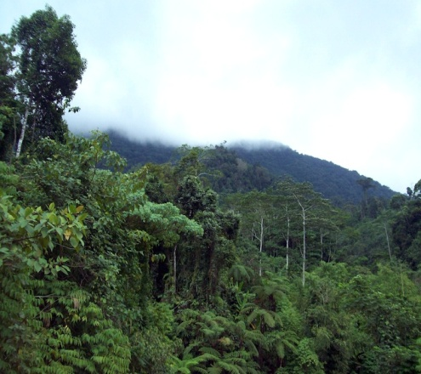
FLR
Notes:
FLR will be the main strategy in some of our future undertakings with development partners like the Food and Agriculture Organization (FAO) proposed project for funding under the Global Environment Facility (GEF 6). The full project document of the proposal has already been finalized and now ready for submission to GEF Secretariat.
Further, additional support on FLR has been confirmed by a Donor, the International Climate Initiative (IKI) of the German Federal Ministry for the environment, Nature Conservation, Building and Nuclear Safety (BMUB), and that the project is expected to be operational this year.
To complete the big picture in forest restoration and management, the country has also embarked in the protection of its natural and residual forests of 6.8 Million hectares through the multi-stakeholders participation of forest communities, local government units, civil society organizations, and with the support of our law enforcement agency.

Slide 7
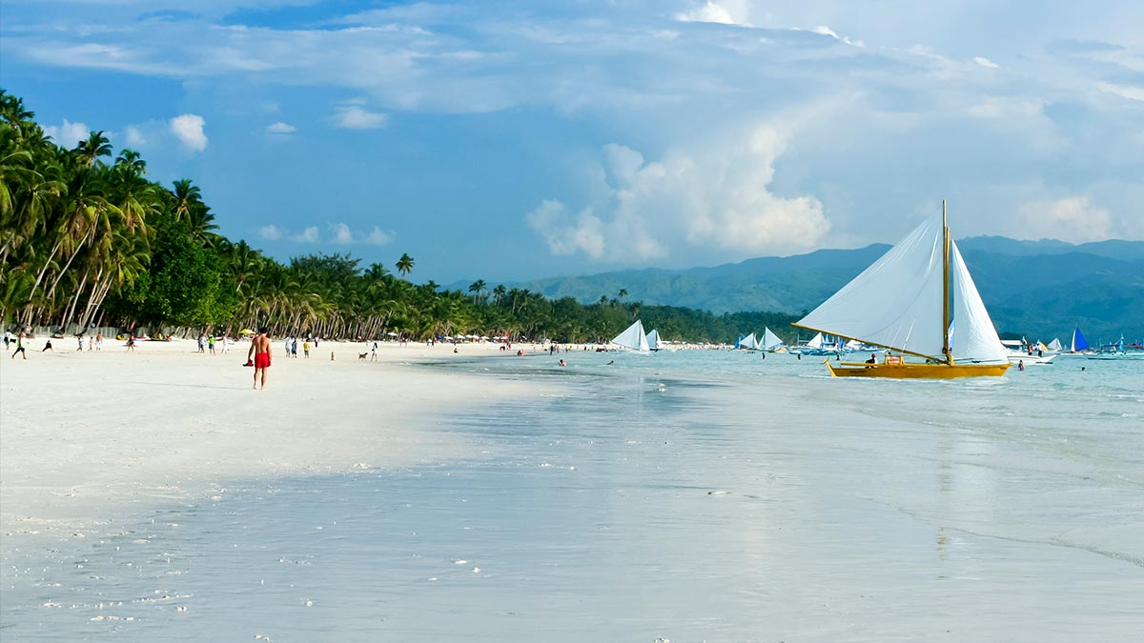
Boracay Island
Notes:
However, we are still facing a lot of challenges in restoring and protecting our environment. We have just finished cleaning up the famous Boracay Island.

Slide 8
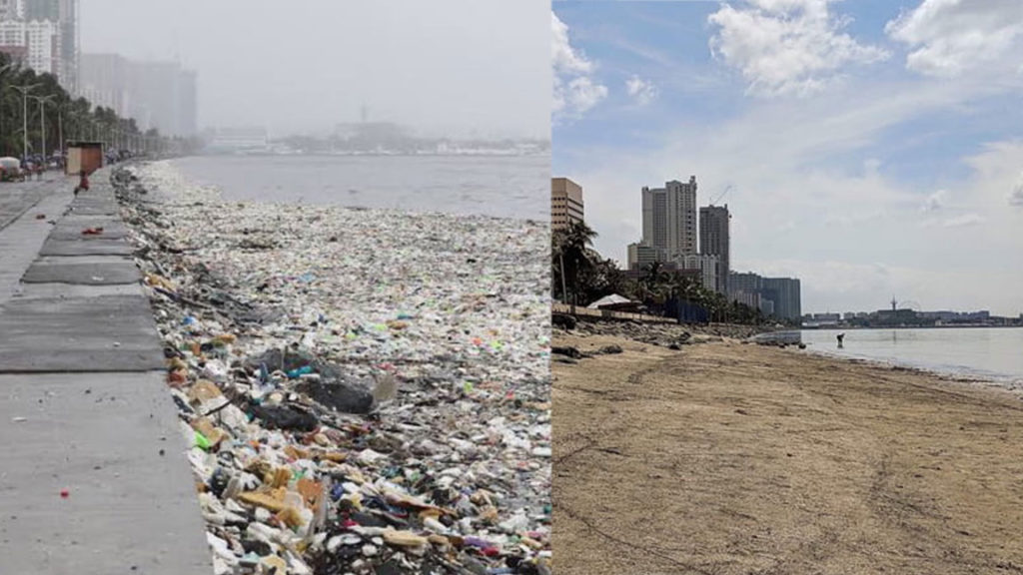
Notes:
Now our bigger challenge is to rehabilitate the Manila Bay dubbed as “Battle for Manila Bay”. DENR Secretary Roy A. Cimatu announced that this is the battle that will be won not with force but with the firm resolve to bring Manila Bay back to life. And for the information of all, the rehabilitation of Manila Bay commenced last 27 January 2019. And I believe that the commitment and active participation showed by every Filipino in rehabilitating Manila Bay on that day is a manifestation that we have already won the battle for Manila Bay.

Slide 9
Notes:
I wish you all a successful discussion today. May all your learnings be the important elements in beefing up efforts toward the restoration of respective degraded forest landscapes.
Maraming salamat. Mabuhay!

